Slide 1

Carry select adder
Ahmed Khaled
Saif Muhammed
Mohamed Abd El wahab
Samar Ibrahim

Slide 2
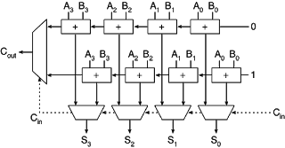
carry select adder :
A carry select adder is an arithmetic combinational logic circuit that adds two N-bit binary numbers and outputs their N-bit binary sum and a 1-bit carry.
There is no different from a ripple carry adder in function, but in design, the carry select adder does not propagate the carry through as many full adders as the ripple carry adder does. This means that the time to add two numbers should be shorter.

Slide 3
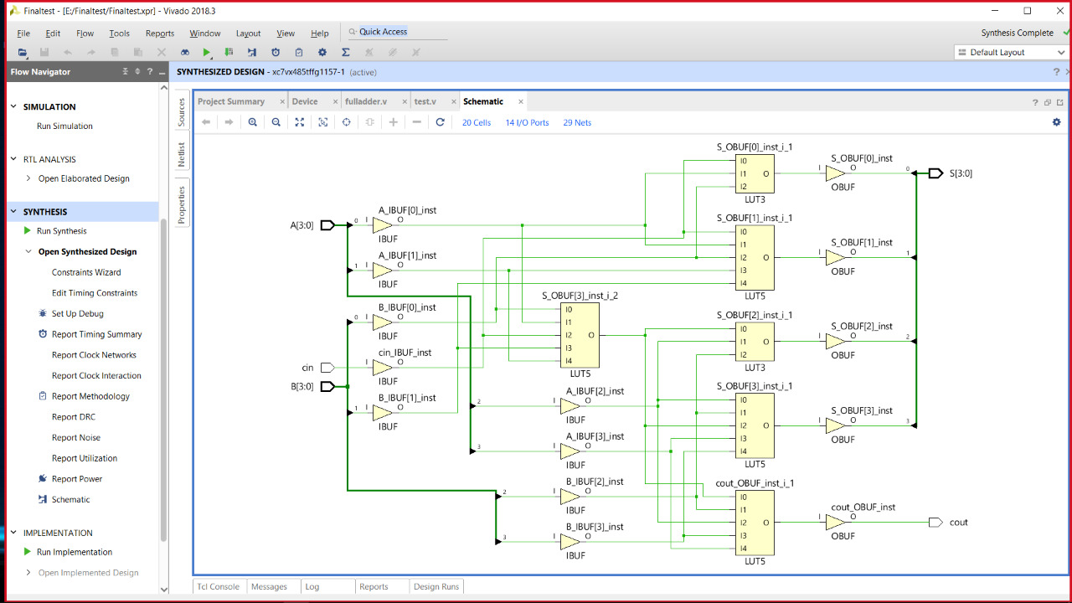
Idea behind a carry select adder:
The idea behind a N-bit carry select adder is to avoid propagating the carry from bit to bit in sequence.
If we have two adders in parallel: one with a carry input of 0, the other with a carry input of 1, then we could use the actual carry input generated to select between the outputs of the two parallel adders.
One of those two will be correct, so they doesn’t wait for the carry out from each other. Then each one can processing immediately. But, how we know which adder’s output should be used.? We need a sub circuit that conceptually acts like a switch (multiplexer).

Slide 4
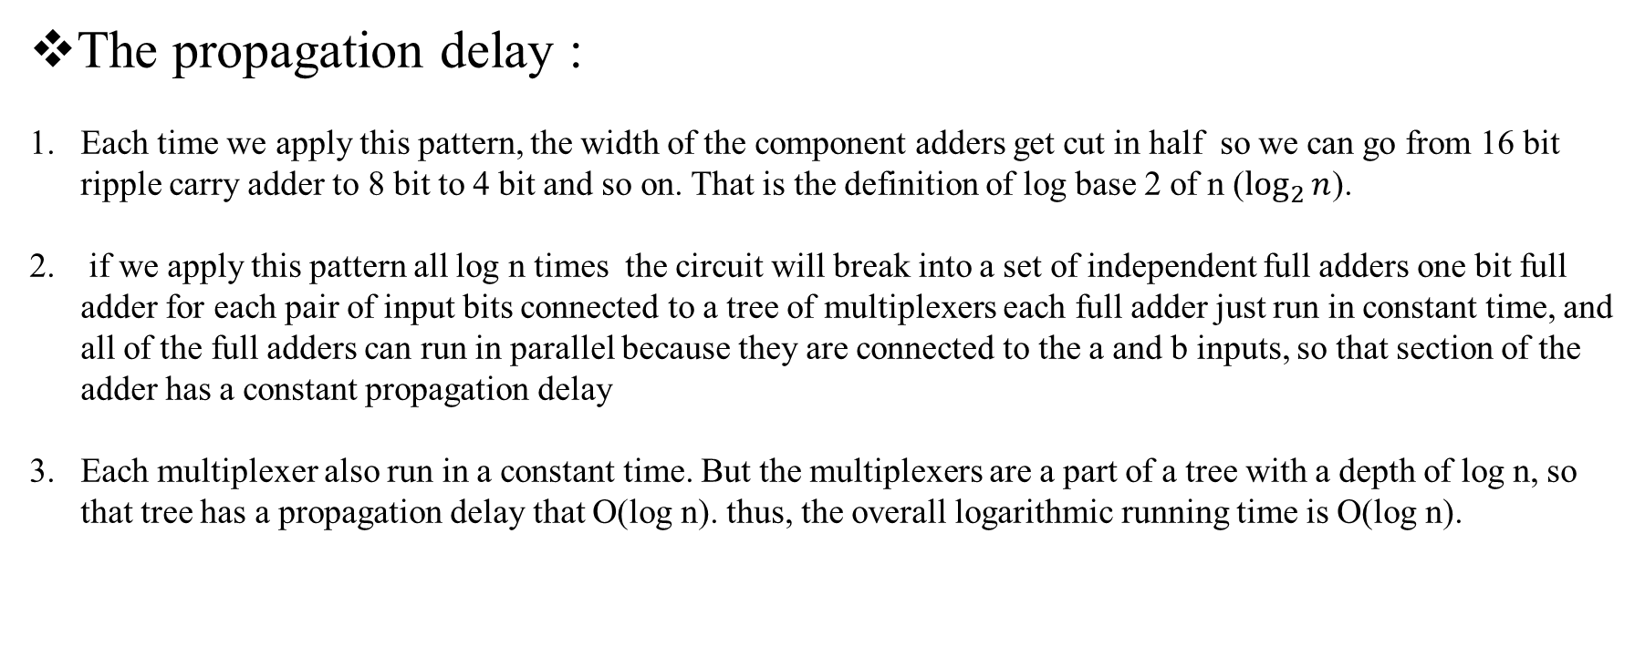
The propagation delay :
Each time we apply this pattern, the width of the component adders get cut in half so we can go from 16 bit ripple carry adder to 8 bit to 4 bit and so on. That is the definition of log base 2 of n ($\log_{2}{n}$).
if we apply this pattern all log n times the circuit will break into a set of independent full adders one bit full adder for each pair of input bits connected to a tree of multiplexers each full adder just run in constant time, and all of the full adders can run in parallel because they are connected to the a and b inputs, so that section of the adder has a constant propagation delay
Each multiplexer also run in a constant time. But the multiplexers are a part of a tree with a depth of log n, so that tree has a propagation delay that O(log n). thus, the overall logarithmic running time is O(log n).

Slide 5
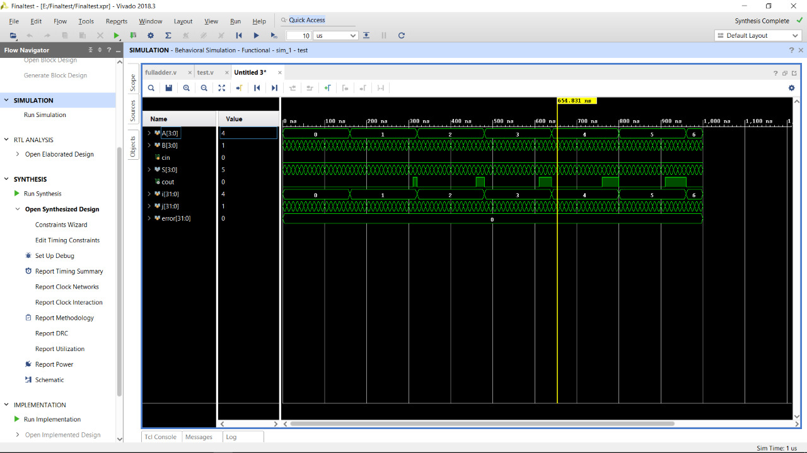
Results:

